Slide 1



COVID BED AVAILABIILITY AND BOOKING SYSTEM
DSA 1 GROUP PROJECT

Slide 2

GROUP MEMBERS
AKSHADA MALPURE -2934
ANUSHKA PAWAR-2945
REENA PRASAD-2946
RUTUJA WASU-2950

Slide 3
ARRAY
DATA STURCTURES USED IN THE PROJECT
SINGLY LINKED LIST
CIRCULAR QUEUE

Slide 4
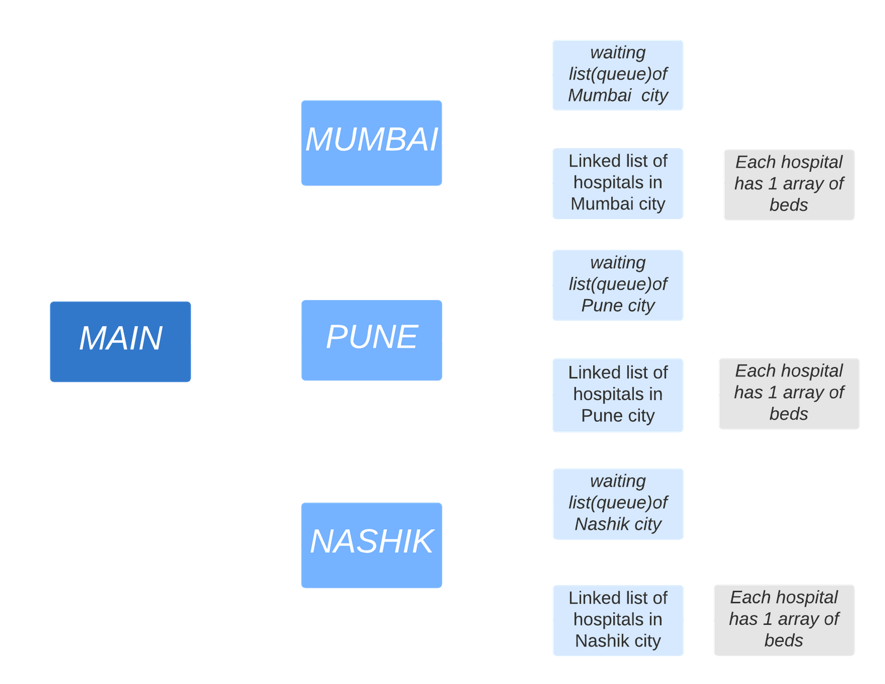
Right now we have limited the size of
QUEUE TO 3
INITIAL LINKED LIST CREATION SIZE -3 HOSPITALS IN A CITY
BEDS ARRAY IN EACH HOSPITAL - 3

Slide 5
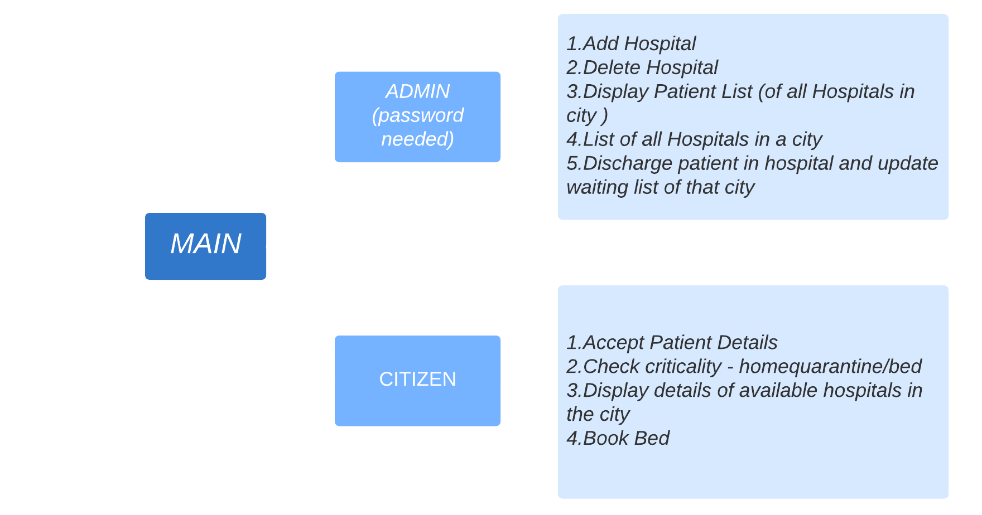

Slide 6
FUTURE SCOPE:
We could Maintained the Record of all Discharged Patients using linked list (if not using database)
can modify criticality determination function for ICU/General ward /home quarantine
As of now we have hardcoded creation of city hospital linked list , it can be modified to user input based
Also number of beds etc could be made a variable and can be accepted from user
We could have used the Database for Storing Details of each and every Patient. Also of various Hospitals and their Information.
Parallel/Simultaneous Programming could have been Implemented
For example in our code : At the same time ADMIN and CITIZEN can do their respective jobs.
GUI can be used to make it more Interactive

